Slide 1
Divide and Conquer
Recursive in structure
  Divide the problem into sub-problems that are similar to the original but smaller in size
  Conquer the sub-problems by solving them recursively. If they are small enough, just solve them in a straightforward manner.
  Combine the solutions to create a solution to the original problem

Slide 2
An Example: Merge Sort
Sorting Problem: Sort a sequence of n elements into non-decreasing order.
Divide: Divide the n-element sequence to be sorted into two subsequences of n/2 elements each
Conquer: Sort the two subsequences recursively using merge sort.
Combine: Merge the two sorted subsequences to produce the sorted answer.

Slide 3

Merge Sort – Example
18
26
32
6
43
15
9
1
22
26
19
55
37
43
99
2
18
26
32
6
43
15
9
1
22
26
19
55
37
43
99
2
18
26
32
6
43
15
9
1
22
26
19
55
37
43
99
2
18
26
32
6
43
15
9
1
22
26
19
55
37
43
99
2
18
26
32
6
43
15
9
1
22
26
19
55
37
43
99
2

Slide 4
Merge Sort – Example
Original Sequence
Sorted Sequence
18
26
32
6
43
15
9
1
18
26
32
6
43
15
9
1
1
6
9
15
18
26
32
43
Divide
18
26
32
6
43
15
9
1
18
26
32
6
43
15
9
1
6
26
32
6
18
26
32
18
1
9
15
43
1
9
15
43
Divide
Divide
18
26
43
15
9
1
18
26
32
6
43
15
9
1
32
6
18
26
6
32
15
43
18
26
6
32
15
43
1
9
1
9
18
26
32
15
1
15
18
26
32
6
43
15
9
1
18
26
6
43
9
26
32
6
43
15
9
9
1
18
32
6
43
1
18
26
32
6
43
15
9
1
18
26
32
6
43
15
9
1
Conquer/Merge

Slide 5
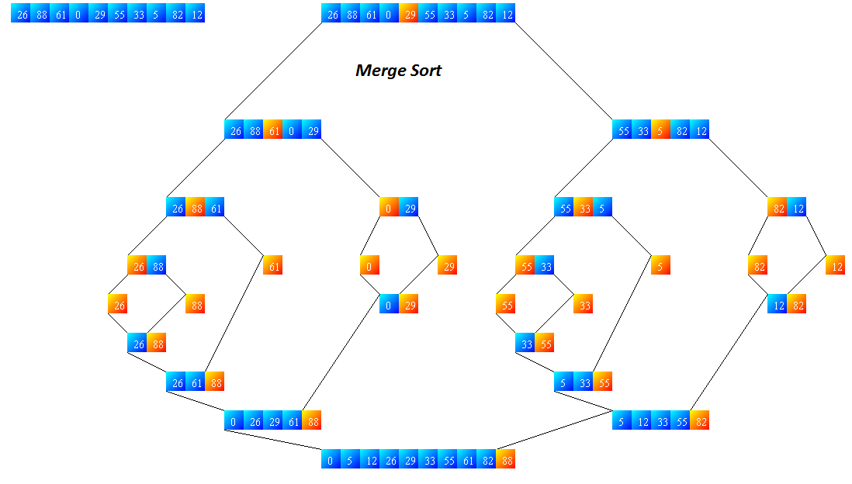
Divide
Divide
Divide
Divide
Divide
Divide
Divide
Divide
Conquer
Divide
Conquer
Conquer
Conquer
Conquer
Conquer
Conquer
Conquer
Conquer

Slide 6
Merge-Sort (A, fst, lst)
INPUT: a sequence of n numbers stored in array A
OUTPUT: an ordered sequence of n numbers
MergeSort (A, fst, lst) // sort A[fst...lst] by divide & conquer
if fst< lst
then mid ← ⎣(fst+lst)/2⎦
MergeSort (A, fst, mid)
MergeSort (A, mid+1, lst)
Merge (A, fst, mid, lst) // merges A[fst..mid] with A[mid+1..lst]
Initial Call: MergeSort(A, 1, n)

Slide 7
Procedure Merge
Merge(A, fst, mid, lst)
1 n₁ ← (mid – fst + 1)
2 n₂ ← (lst – mid)
for i ← 1 to n₁
do L[i] ← A[fst+ i – 1]
for j ← 1 to n₂
do R[j] ← A[mid + j]
L[n₁+1] ← ∞
R[n₂+1] ← ∞
i ← 1
j ← 1
for k ←fst to lst
do if L[i] ≤ R[j]
then A[k] ← L[i]
i ← i + 1
else A[k] ← R[j]
j ← j + 1
Input: Array containing sorted subarrays A[fst...mid] and A[mid+1…lst]
Output: Merged sorted subarray in A[fst...lst].
Sentinels, to avoid having to
check if either subarray is
fully copied at each step.
i
L
n1
j
R
n2
k
A
fst
lst

Slide 8
Merge – Example
A
…
6
8
26
32
1
9
42
43
…
1
6
8
9
26
32
42
43
k
k
k
k
k
k
k
k
k
L
6
8
26
32
∞
R
6
8
26
32
1
9
42
43
∞
1
9
42
43
i
i
i
i
i
j
j
j
j
j

Slide 9
Analysis of Merge Sort
Running time T(n) of Merge Sort:
Divide: computing the middle takes Θ(1)
Conquer: solving 2 subproblems takes 2T(n/2)
Combine: merging n elements takes Θ(n)
Total:
    T(n) = Θ(1) if n = 1
    T(n) = 2T(n/2) + Θ(n) if n > 1
  ⇒ T(n) = Θ(n lg n) (CLRS, Chapter 4)

Slide 10
Merge-Sort (A, fst, lst)
INPUT: a sequence of n numbers stored in array A
OUTPUT: an ordered sequence of n numbers
MergeSort (A, fst, lst) // sort A[fst...lst] by divide & conquer
if fst< lst
then mid ← ⎣(fst+lst)/2⎦
MergeSort (A, fst, mid)
MergeSort (A, mid+1, lst)
Merge (A, fst, mid, lst) // merges A[fst..mid] with A[mid+1..lst]
Initial Call: MergeSort(A, 1, n)

Slide 11
Procedure Merge
Merge(A, fst, mid, lst)
1 n₁ ← (mid – fst + 1)
2 n₂ ← (lst – mid)
for i ← 1 to n₁
do L[i] ← A[fst+ i – 1]
for j ← 1 to n₂
do R[j] ← A[mid + j]
L[n₁+1] ← ∞
R[n₂+1] ← ∞
i ← 1
j ← 1
for k ←fst to lst
do if L[i] ≤ R[j]
then A[k] ← L[i]
i ← i + 1
else A[k] ← R[j]
j ← j + 1
Input: Array containing sorted subarrays A[fst...mid] and A[mid+1…lst]
Output: Merged sorted subarray in A[fst...lst].
Sentinels, to avoid having to
check if either subarray is
fully copied at each step.
i
L
n1
j
R
n2
k
A
fst
lst

Slide 12
Merge – Example
A
…
6
8
26
32
1
9
42
43
…
1
6
8
9
26
32
42
43
k
k
k
k
k
k
k
k
k
L
6
8
26
32
∞
R
6
8
26
32
1
9
42
43
∞
1
9
42
43
i
i
i
i
i
j
j
j
j
j

Slide 13
Analysis of Merge Sort
Running time T(n) of Merge Sort:
Divide: computing the middle takes Θ(1)
Conquer: solving 2 subproblems takes 2T(n/2)
Combine: merging n elements takes Θ(n)
Total:
    T(n) = Θ(1) if n = 1
    T(n) = 2T(n/2) + Θ(n) if n > 1
  ⇒ T(n) = Θ(n lg n) (CLRS, Chapter 4)

Slide 14
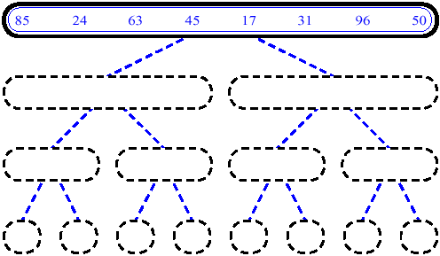
MergeSort (Example) - 1

Slide 15
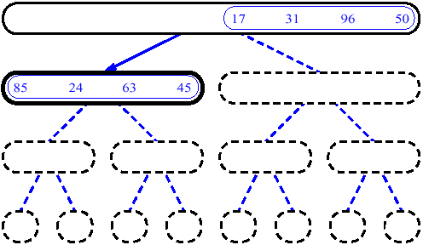
MergeSort (Example) - 2

Slide 16
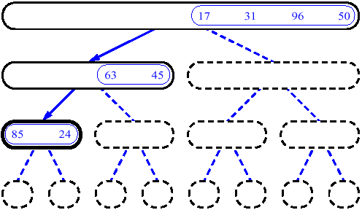
MergeSort (Example) - 3

Slide 17
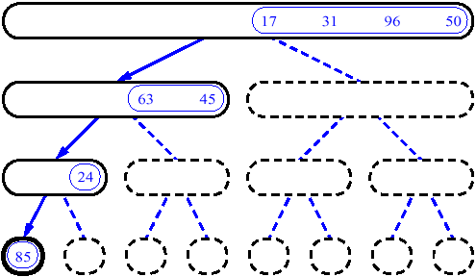
MergeSort (Example) - 4

Slide 18
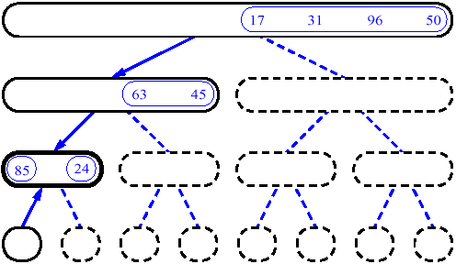
MergeSort (Example) - 5

Slide 19
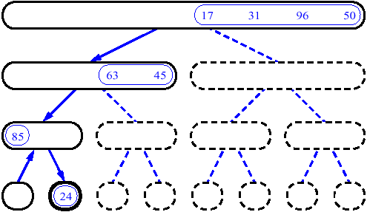
MergeSort (Example) - 6

Slide 20
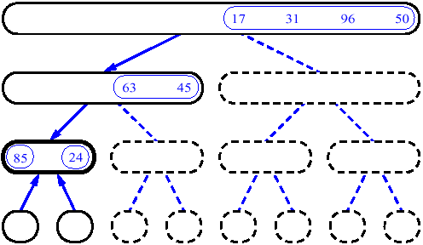
MergeSort (Example) - 7

Slide 21
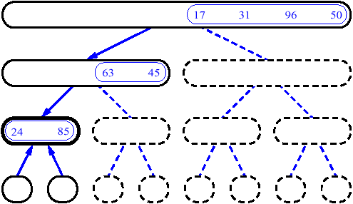
MergeSort (Example) - 8

Slide 22
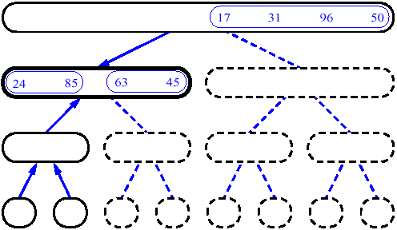
MergeSort (Example) - 9

Slide 23
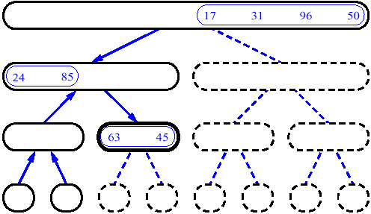
MergeSort (Example) - 10

Slide 24
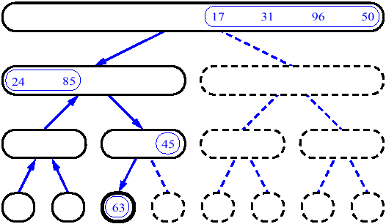
MergeSort (Example) - 11

Slide 25
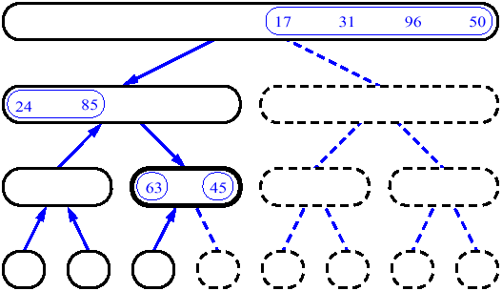
MergeSort (Example) - 12

Slide 26
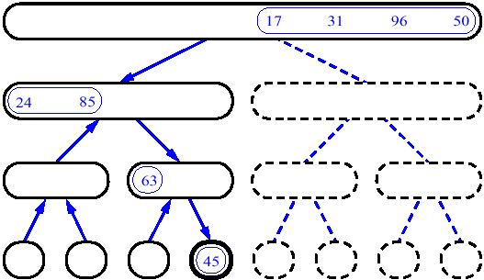
MergeSort (Example) - 13

Slide 27
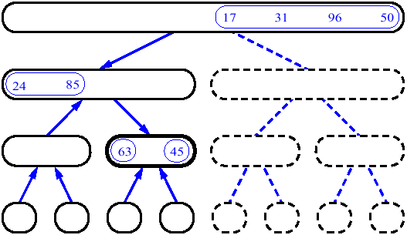
MergeSort (Example) - 14

Slide 28
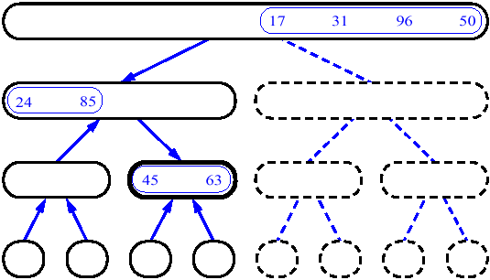
MergeSort (Example) - 15

Slide 29
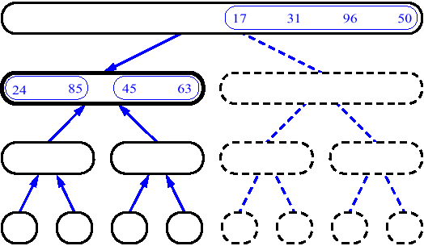
MergeSort (Example) - 16

Slide 30
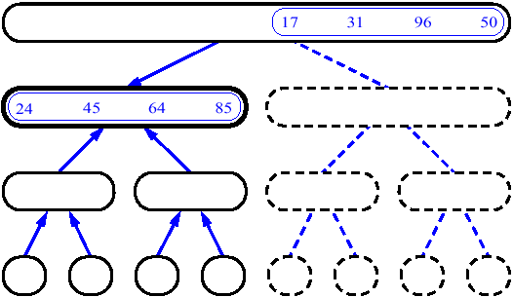
MergeSort (Example) - 17

Slide 31
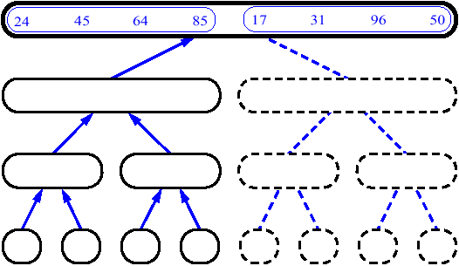
MergeSort (Example) - 18

Slide 32
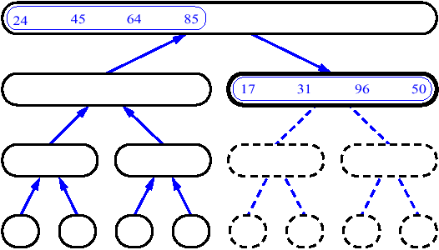
MergeSort (Example) - 19

Slide 33
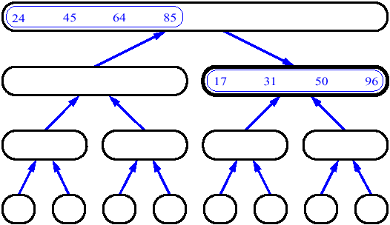
MergeSort (Example) - 20

Slide 34
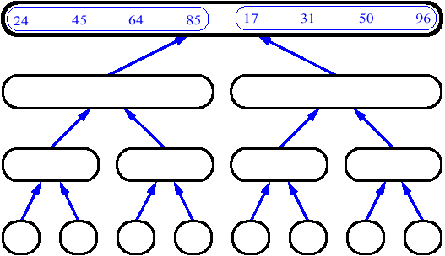
MergeSort (Example) - 21

Slide 35
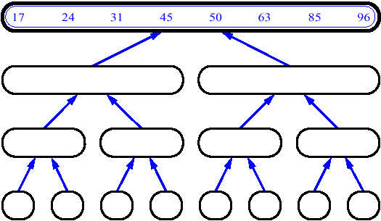
MergeSort (Example) - 22

